Slide 1

Library system
Group 9
VICTOR Sebastian Valencia CORREA-986775
Carlos ALBERTO Hernandez OSPINA-986636

Slide 2
outline
Application demo
Use case diagram
Class diagram
Use cases implemented:
Login
Add new member
Check out book
Add book copy
Add book
Print checkout record
Query overdue books

Slide 3
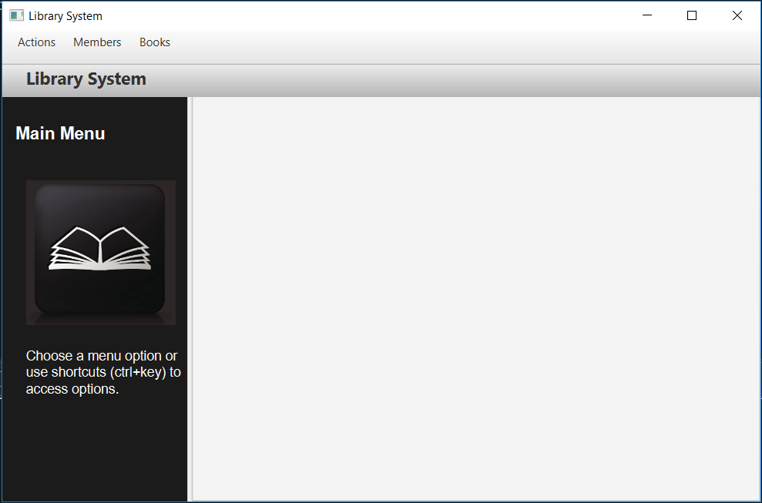
Library system

Slide 4
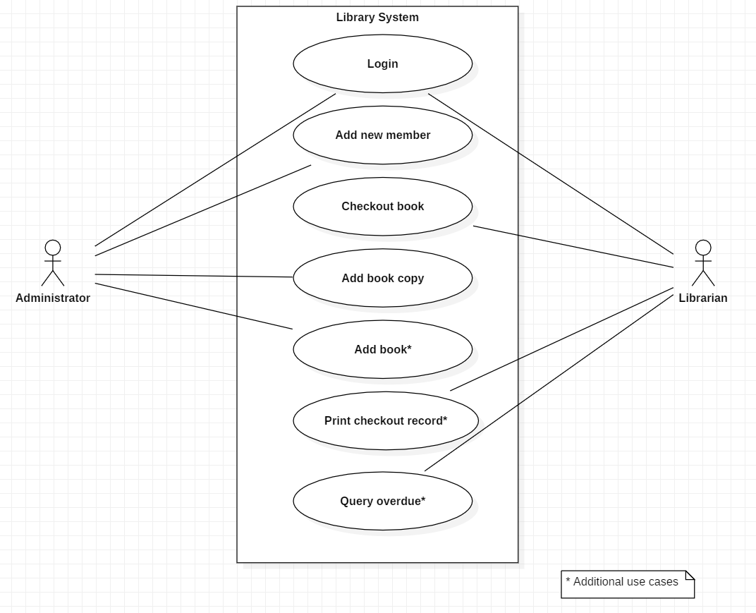
Use cases

Slide 5
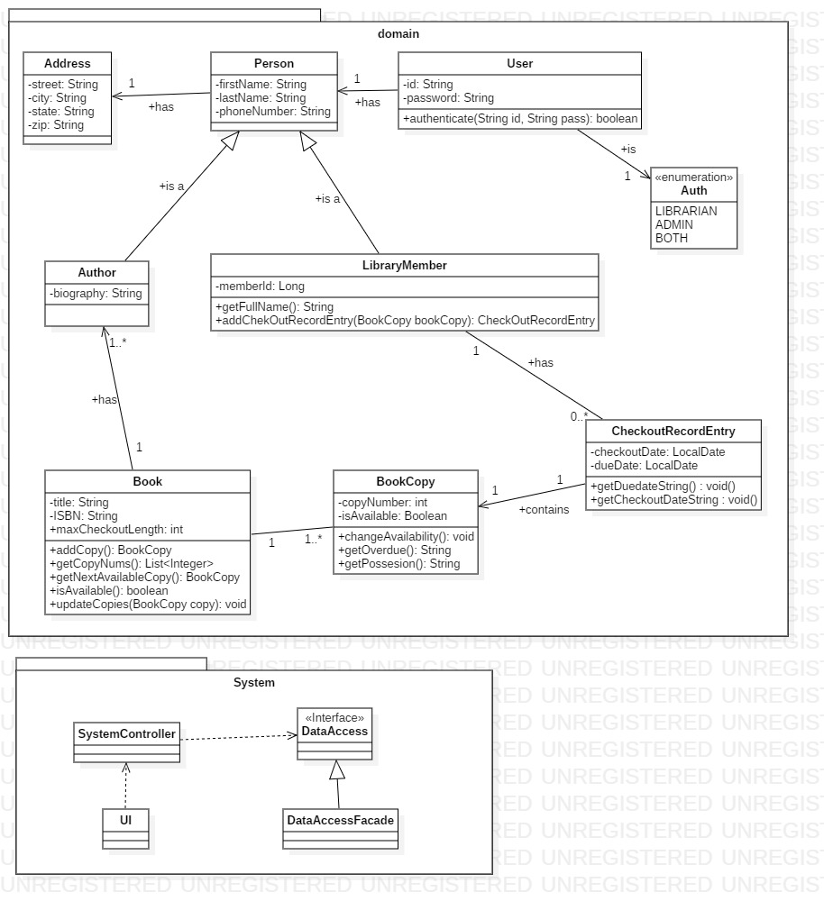
Class diagram

Slide 6
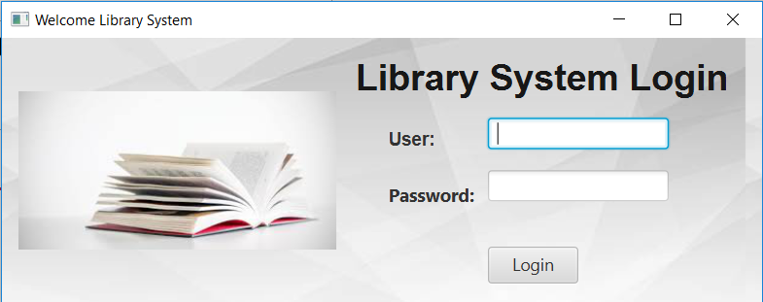
Use case 1: login
Validate user and password against persistence.
Configure access level: Administrator, Librarian or Both

Slide 7
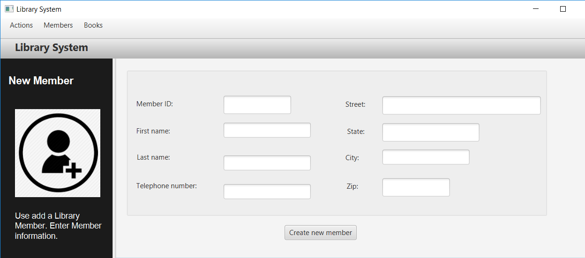
Use case 2: add member
Once data is validated, is saved in the persistence.

Slide 8
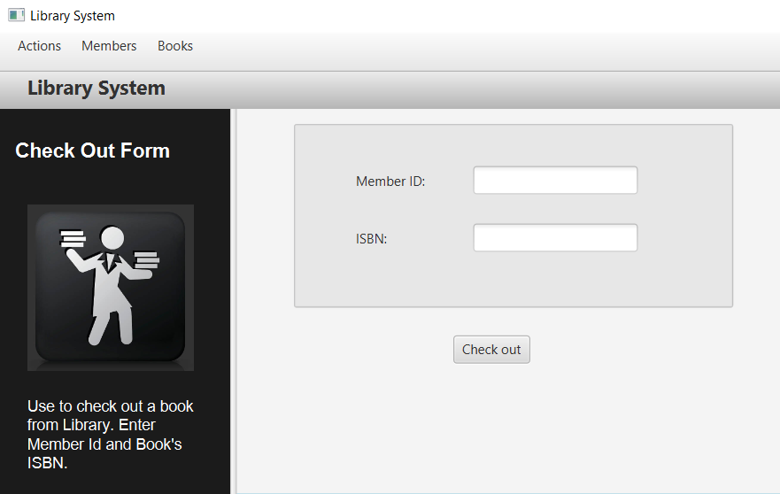
Use case 3: check out a book
Marks copy as unavailable and saves checkout record entry in persistance.

Slide 9
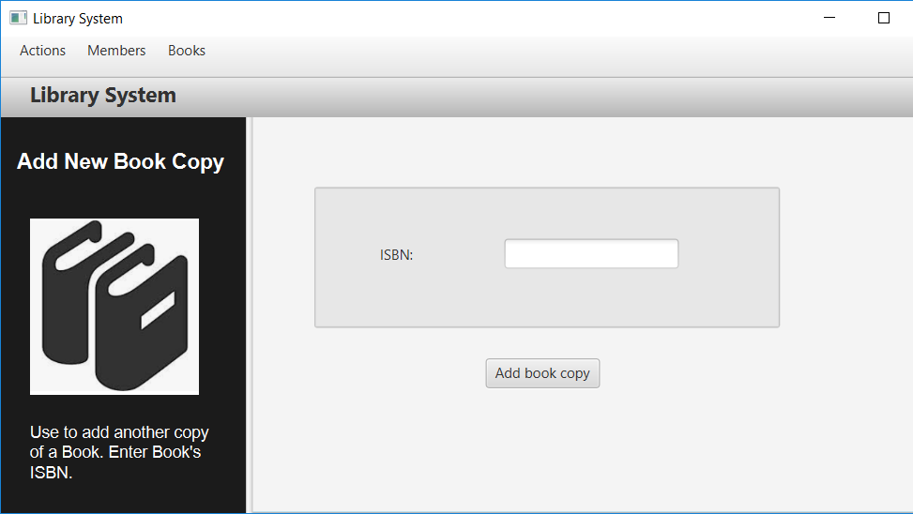
Use case 4: add book copy
Adds copy of existing books to the library.

Slide 10
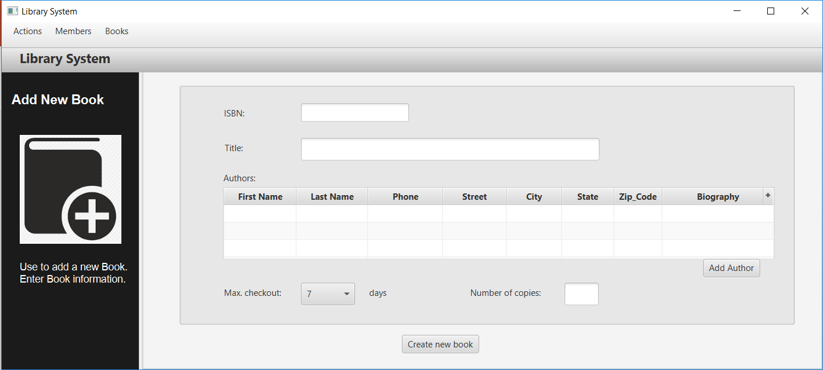
Use case 5: add book
Add book to the library.

Slide 11
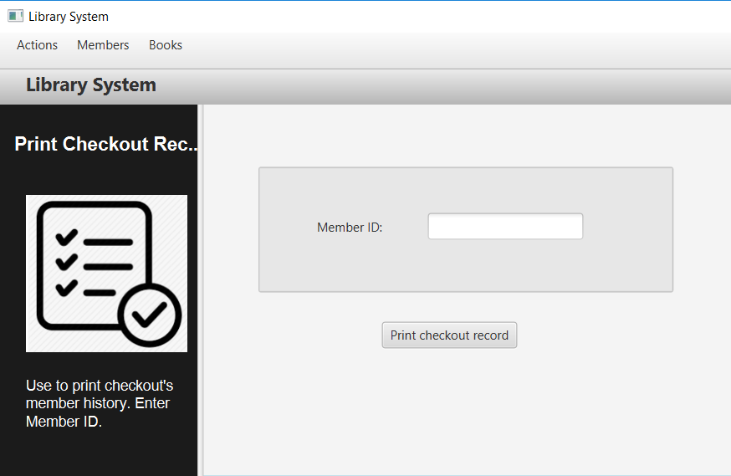
Use case 6: print checkout record
Prints checkout history to console.

Slide 12
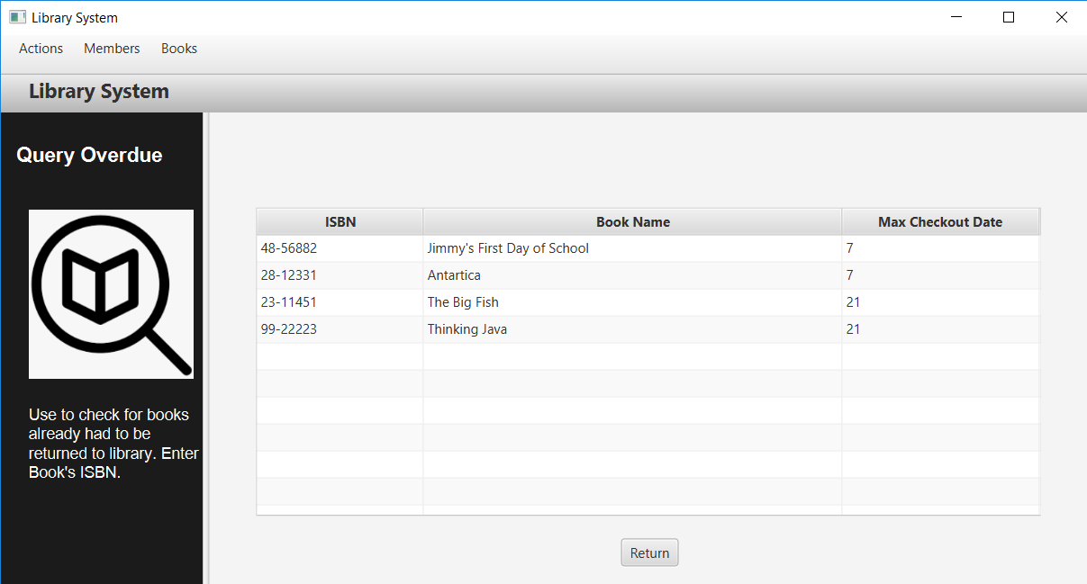
Use case 7: query overdue books
Helps to find out overdue books and who did checkout.

Slide 13

thanks

